Slide 1

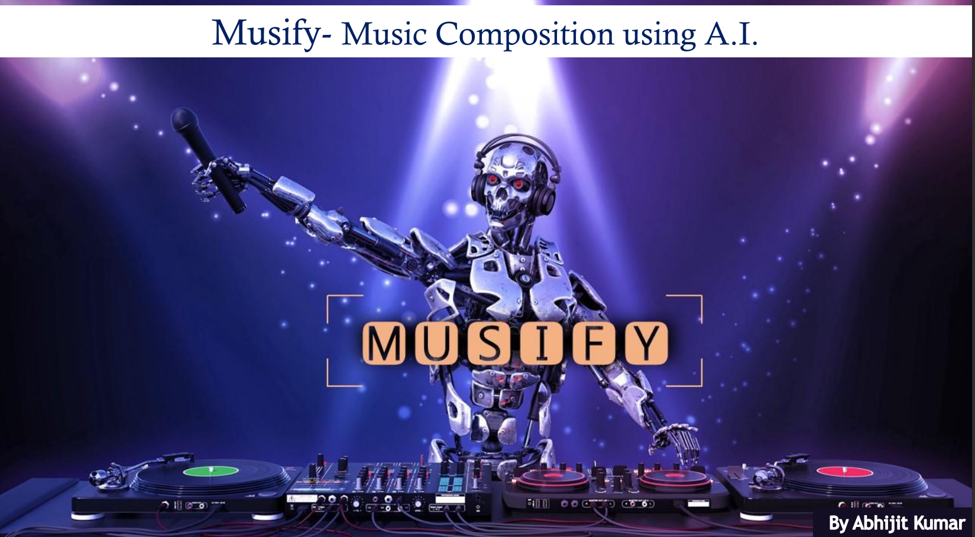

Janhavi Sonawane

Slide 2
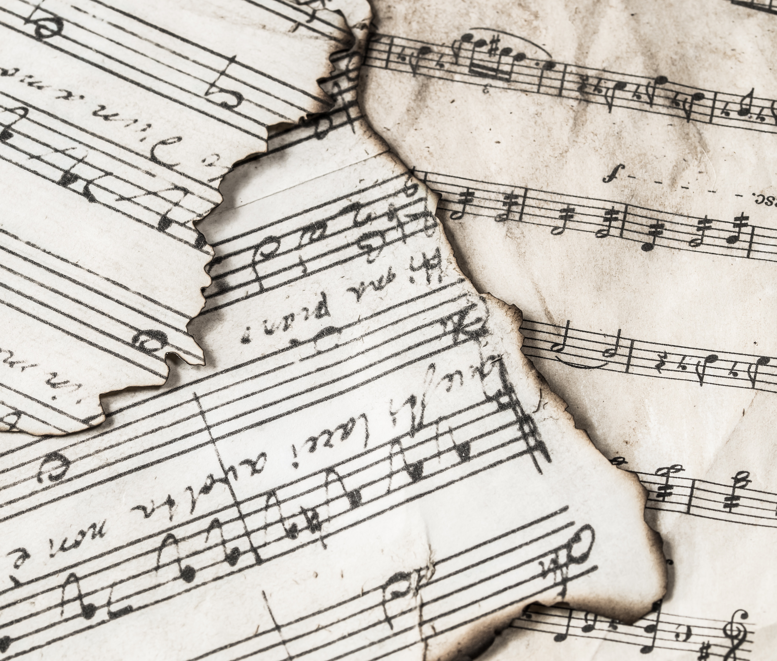
Music composition using A.I
Music composition is the process of creating new music that is an original work either vocal or instrumental.
The art of creating music is a very beautiful process and the fact that now we can create pleasant music by putting together musical notes using A.I/ machine learning is amazing!
Pitch interval, notes, chords, tempo, etc. Are used for composing short piece of music.

Slide 3
About the Project
The project mainly uses music from the instrument Piano.
We use Long Short Term Memory (LSTM), a type of Recurrent Neural Network (RNN).
I have used Visual Studio Code as my platform.
Language used : Python 3.9.13
Libraries : Numpy, Music21, Keras, Sklearn, tqdm, Tensorflow
Dataset : Mentioned in github

Slide 4
Libraries
NumPy : NumPy is a Python library used for working with arrays. It also has functions for working in domain of linear algebra, Fourier transform, and matrices
Music21 : Music21 is a Python toolkit used for computer-aided musicology. It allows us to teach the fundamentals of music theory, generate music examples and study music. The toolkit provides a simple interface to acquire the musical notation of MIDI files. Additionally, it allows us to create Note and Chord objects so that we can make our own MIDI files easily.
Keras : Keras is a high-level neural networks API that simplifies interactions with TensorFlow. It was developed with a focus on enabling fast experimentation.
Sci-kit learn(sklearn) : Scikit-learn (Sklearn) is the most useful and robust library for machine learning in Python. It provides a selection of efficient tools for machine learning.
Tqdm : tqdm is a library in Python which is used for creating Progress Meters or Progress Bars.
Tensorflow : TensorFlow is a free and open-source software library for machine learning and artificial intelligence • It can be used across a range of tasks but has a particular focus on training and inference of deep neural networks.

Slide 5
Project Structure
MOD/ : This directory conatins optimizer, metrics, and weights of our trained model.
Dataset used for the code/ : Dataset folder containing the midi files of different composers.
Code.ipynb : This is the code for the project where we build, train, and test our model.
AI_composed_musicfinal.mid : This is the music file

Slide 6
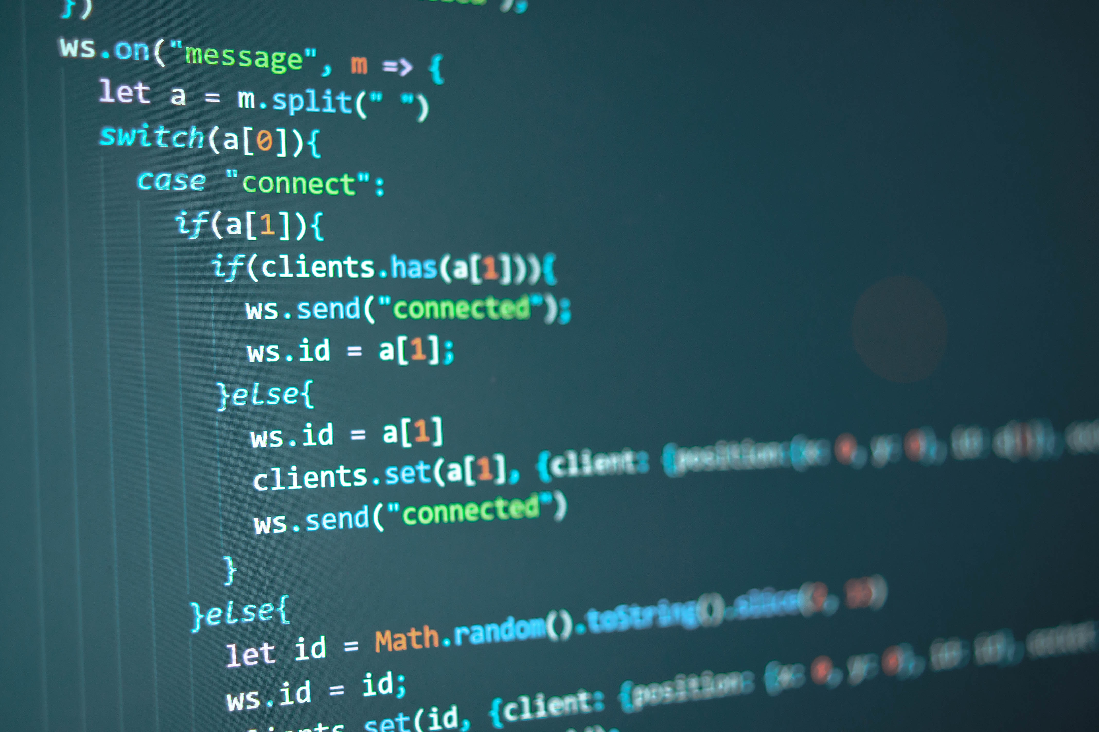
STEPS {Developing the code from scratch}

Slide 7
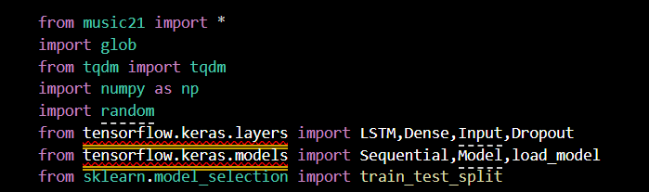
STEP 1: Import libraries
Code Snippet

Slide 8
STEP 2: Reading and Parsing the Midi file
• The midi file dataset has to be read using Music21 library
• "borodin" , "bach" , "brahms" are the midi files that I used.
• For this project, the files that contain sequential streams of Piano data has only been worked on
• All files are separated by their instruments and Piano is used only
• Piano stream from the midi file contains many data like Keys, Time Signature, Chord, Note etc.
• We require only Notes and Chords to generate music
• Lastly, the arrays of notes and chords has to be returned

Slide 9
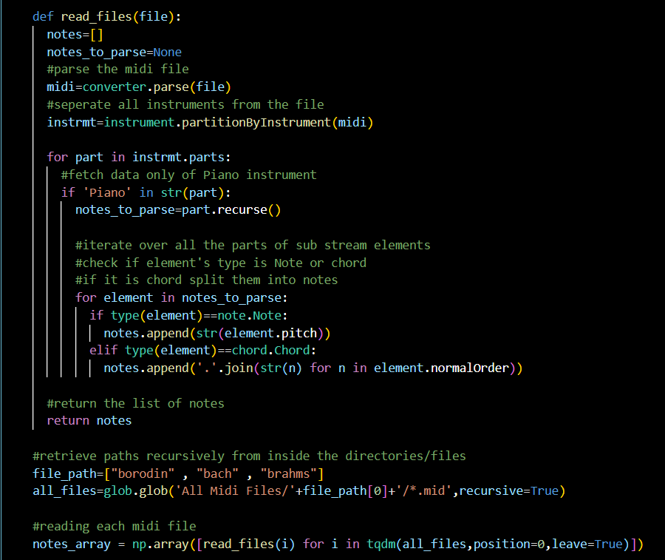
Code Snippet

Slide 10
STEP 3: Exploring the Dataset
• This is done to check the number of unique notes and their distribution
• 30 is used as a threshold frequency
• Only those notes which have frequencies more than 30 have been considered • These parameters can be changed anytime
• Two dictionaries are created where one will have notes index as a key and notes as value and other will be the reverse of the first i.e. key will be notes and value will be its respective index
• These dictionaries will be used in the next steps

Slide 11
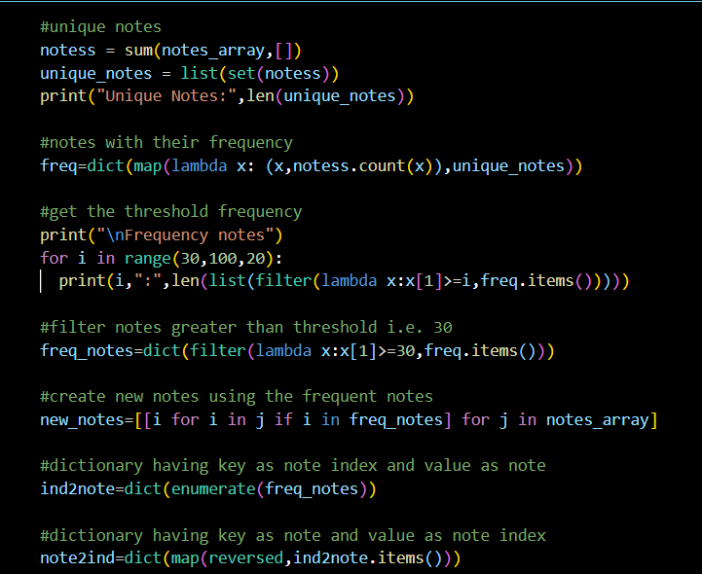
Code Snippet

Slide 12
STEP 4: Input and Output Sequence for model
• Input and output sequences for our model are created.
• A timestep of 60 has been used. So, if we traverse 60 notes of our input sequence then the 51st note will be the output for that sequence.
• As our model requires numeric data, all notes are converted to its respective index value using the “note2ind” (note to index) dictionary which has been created earlier.

Slide 13
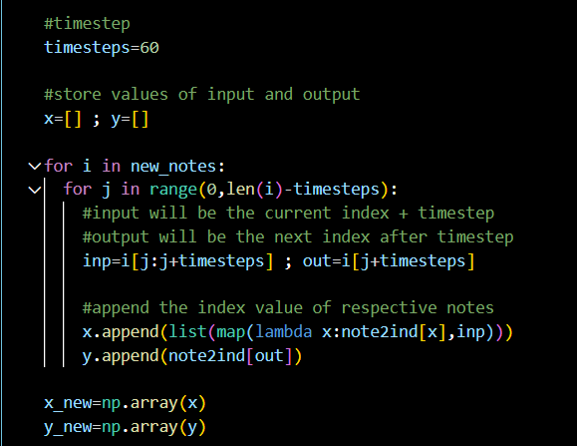
Code Snippet

Slide 14
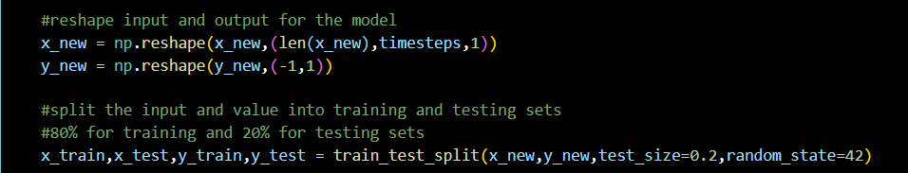
STEP 5: Training and Testing sets
Array for our model is re-shaped and the data is split into 80:20 ratio.

Slide 15
STEP 6: Building the Model
• 2 stacked LSTM layers with a dropout rate of 0.2 are used.
• A fully connected Dense layer has been used for output.
• Output dimension of the Dense Layer is taken same as the length of our unique notes along with the ‘softmax’ activation function (Used for multi-class classification problems).

Slide 16
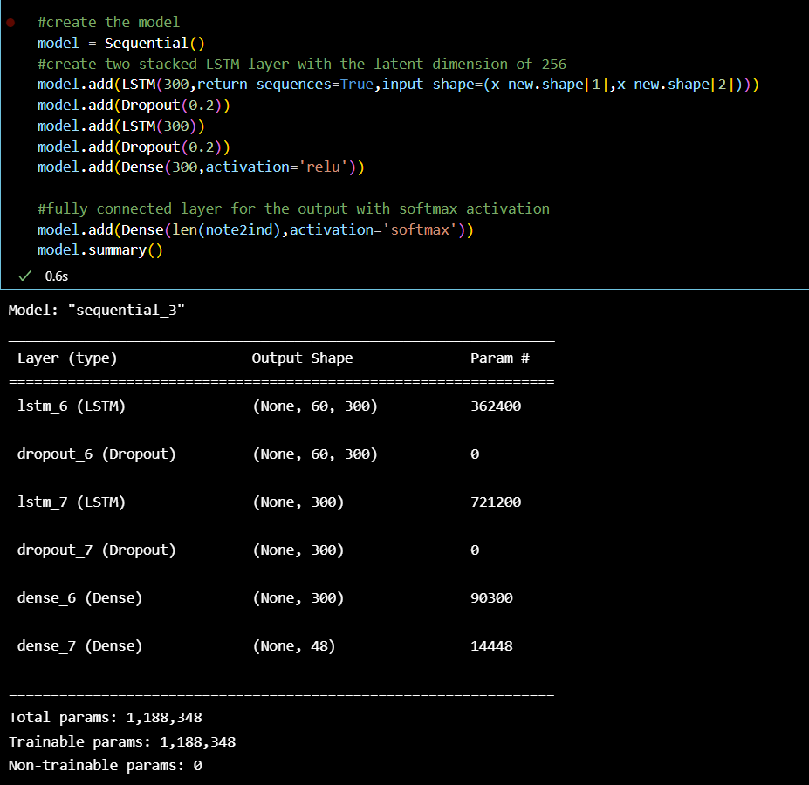
Code Snippet

Slide 17
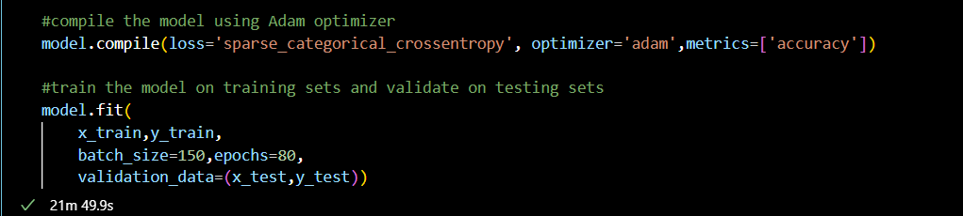
STEP 7: Training the Model
• After building the model, it is trained on the input and output data
• For this, ‘Adam’ optimizer is used on batch size of 150 and for total 80 epochs
• After Training, model is saved for prediction
Code Snippet

Slide 18
STEP 8: Inference Phase
• Using the trained model, the notes will be predicted
• A random integer(index) is generated for our testing input array which will be our testing input pattern
• Our array is then re-shaped and the output is predicted
• Using the ‘np.argmax()’ function, we get the data of the maximum probability value
• This predicted index is converted to notes using ‘ind2note’(index to note) dictionary
• Our next music pattern is one step ahead of the previous pattern • This process is repeated till we generate 200 notes
• This parameter can be changed as per your requirements

Slide 19
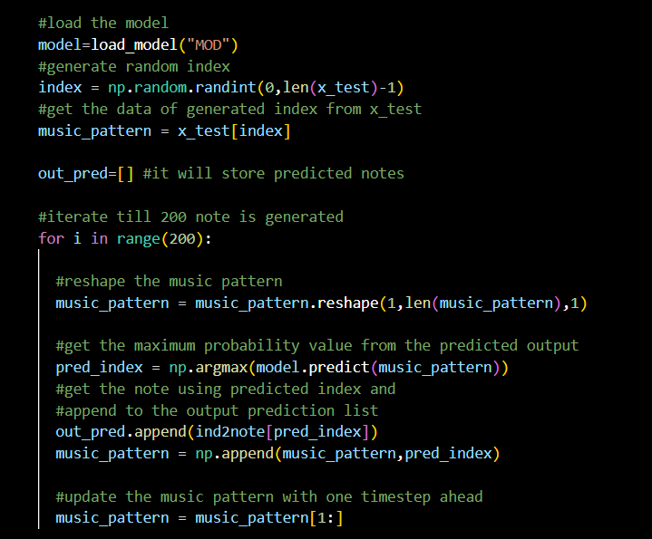

Slide 20
STEP 9: Saving the File
The predicted output notes are saved into a MIDI File

Slide 21
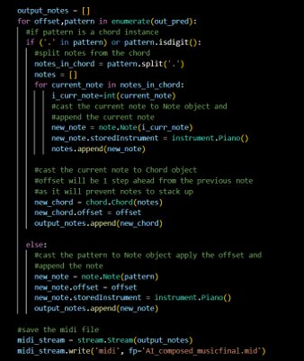
Code Snippet

Slide 22
THANK YOU!

